Slide 1
Chapter 7
Counters and Registers

Slide 2
Introduction
Circuits for counting are needed in computer and digital systems
A Counter circuit consists of a series of flip-flops (FFs) connected together to produce a sequence of states
The state is often referred as a “modulo”
  For example:
    Counter that counts from 0000 to 1111 is called modulo-16 counter, because it has 16 states.

Slide 3
Types of Counters
Counters can be classified into two categories:
  Asynchronous (Ripple) Counters
    The first FF is connected to external clock pulse and then each successive FF clock (CLK) is connected to the output (Q) of the previous FF
  Synchronous Counters
    Every FF is connected to an external clock pulse

Slide 4
7-1 Asynchronous (Ripple) Counters
A counter can count up or down by ones, twos or as desired.
A four-stage counter will have 16 stable states
  RECALL : 2⁴ = 16
  Therefore, Four-stage counter can be called as MODOULU-16 Counter

Slide 5
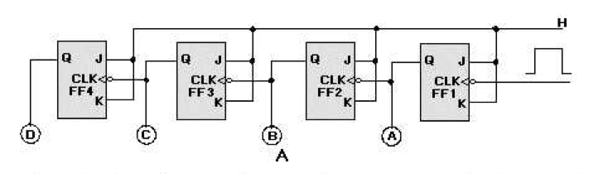
7-1 Asynchronous (Ripple) Counters
Asynchronous counter have the first flip-flop connected to an external clock and the rest of the flip-flop clocks are connected to the output of the previous flip-flop

Slide 6
0 | 0 | 0 | 0
0 | 0 | 0 | 1
0 | 0 | 1 | 0
0 | 0 | 1 | 1
0 | 1 | 0 | 0
0 | 1 | 0 | 1
0 | 1 | 1 | 0
0 | 1 | 1 | 1
1 | 0 | 0 | 0
1 | 0 | 0 | 1
1 | 0 | 1 | 0
1 | 0 | 1 | 1
1 | 1 | 0 | 0
1 | 1 | 0 | 1
1 | 1 | 1 | 0
1 | 1 | 1 | 1

Slide 7
CLK
FF1
FF2
FF3
FF4
0000
0001
0010
0011
0100
0101
0110
0111
1000
1001
1010

Slide 8
Frequency Division
In any counter the signal at the output of the last flip-flop will have a frequency equal to the input clock frequency divided by the MOD number of the counter.
E.g.
  For a MOD-16 counter, the output from the last FF will have a frequency of 1/16 of the input clock frequency.

Slide 9
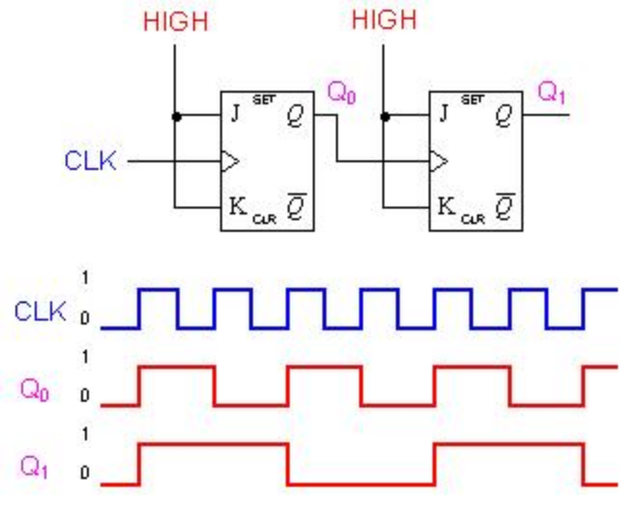
Frequency Division
For the first flip-flop the frequency will be 1/2 of the original CLK frequency. While for the second flip-flop the frequency will be 1/4 of the original CLK frequency.
GOLDEN RULE: for each flip-flop. Divide by 2 !

Slide 10
Question!
How many flip-flops are required for a MOD-32 counter?
2⁵ = 32, therefore 5 Flip-Flops are required
Now!
How many flip-flops are required for a MOD-60 counter?
2⁶ =64 >60 !!!!!
In the next lecture, we will find a solution to obtain 60 counts only.

Slide 11
7-2 Counters with MOD number less than 2^{n}
In the previous lecture, we’ve learned about counters that are limited to MOD numbers equal to 2^{N,} where N is the number of Flip-Flops.
The basic counter can be modified to produce MOD number that is less than 2^{N} by allowing the counter to skip some states.
This can be achieved by forcing the counter to recycle the count before going through all the states.

Slide 12
7-2 Counters with MOD number less than 2^{n}
A Famous counter of this type is the decade counter MOD-10. That counts from 0000 (0) to 1010 (10). It is often called BCD counter because it uses only the 10 BCD group
Clock | Q3 | Q2 | Q1 | Q0
0 | 0 | 0 | 0 | 0
1 | 0 | 0 | 0 | 1
2 | 0 | 0 | 1 | 0
3 | 0 | 0 | 1 | 1
4 | 0 | 1 | 0 | 0
5 | 0 | 1 | 0 | 1
6 | 0 | 1 | 1 | 0
7 | 0 | 1 | 1 | 1
8 | 1 | 0 | 0 | 0
9 | 1 | 0 | 0 | 1

Slide 13
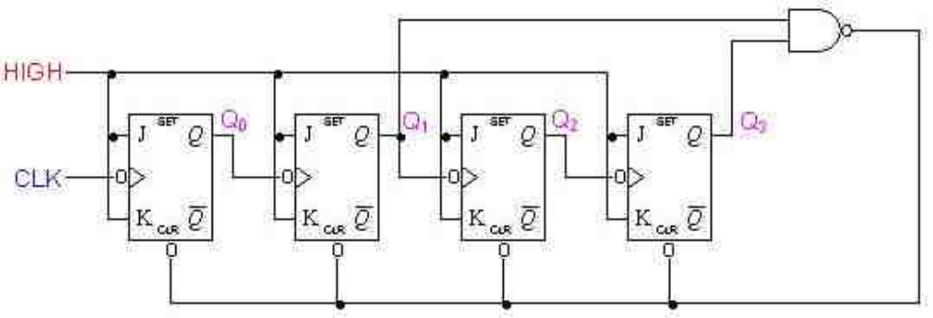
7-2 Counters with MOD number less than 2^{n}

Slide 14
Changing the MOD number
To design a counter of MOD-X:
    1.Find the smallest number of FFs such that 2^{N} ≥ X, and connect them as a counter. If 2^{N} = X then skip the next steps.
    2. Connect a NAND gate to the asynchronous CLEAR inputs of all the FFs.
    3. Determine which FFs will be in the HIGH state at a count = X; then connect the normal outputs of these FFs to the NAND gate inputs.

Slide 15
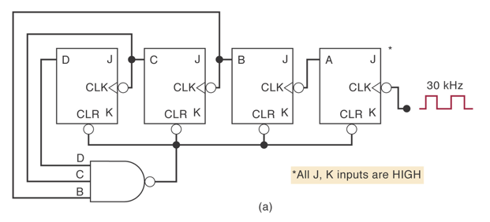
Example 1
What is the MOD number of the following Counter ? And what is the frequency at D ?
MOD-14, (1110) . At D, the frequency would be 30kHz / 14 = 2.14 kHz

Slide 16
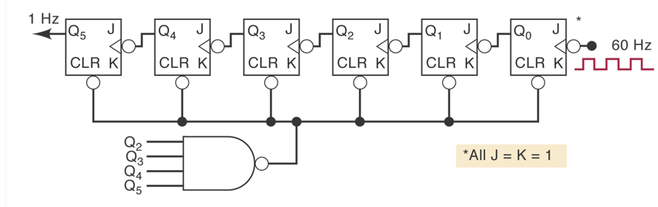
Example 2
Design a MOD-60 counter
2⁶ = 64
000000, …., 111011, Reset at 60 111100, 111101…
0 59 60 61

Slide 17
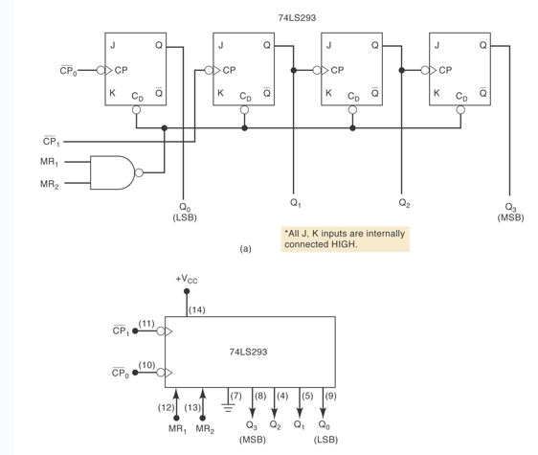
7-3 IC ASYNCHRONOUS COUNTERS
There are several TTL and CMOS asynchronous counter ICs. One of them is the TTL 74LS293

Slide 18
7-3 IC ASYNCHRONOUS COUNTERS
    It has four J-K flip-flops, with outputs Q₃Q₂Q₁Q₀
    Each FF has a CP (clock pulse) input, just another name for CLK. The clock inputs to Q₁ and Q_{0,} labeled (CP₀)’ and (CP₁)’ are externally accessible (pin 11 and 10, respectively).
    Each FF has an asynchronous CLEAR input C_{D}. These are
    Flip flops Q₃Q₂Q₁ are connected as a 3-bit ripple counter.
    Flip flop Q0 is not connected to anything internally. This allows the user the option of either connecting Q₀ to Q₁ to form a 4-bit counter or using Q₀ separately if desired.

Slide 19
74LS293

Slide 20
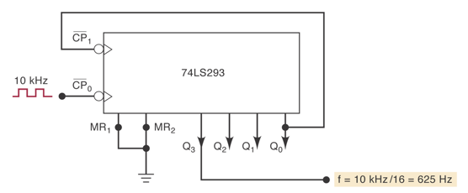
Example 3
Show how the 74LS293 should be connected to operate as a MOD-16 counter with a 10-kHz clock input. Determine the frequency at Q₃.
MOD-16 needs 4 FFs. Therefore, The output of Q₀ must be connected to the next FF. Assume a clock frequency of 10 kHz, therefore Frequency at Q₃ would equal 10kHz/16 = 625 kHz

Slide 21
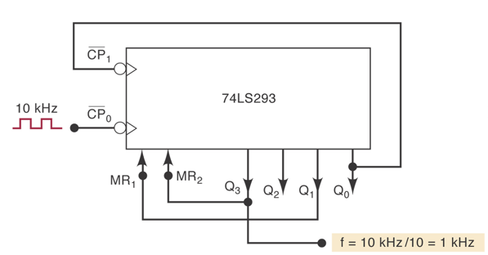
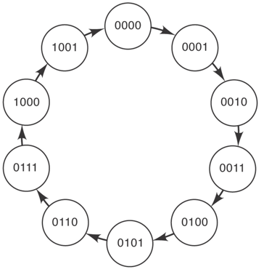
Example 4
Show how to wire the 74LS293 as a MOD-10 counter.
MOD-10 requires 4 FF’s. To count up to (10) 1010, Q1 and Q3 must be connected to MR inputs (NAND gate)

Slide 22
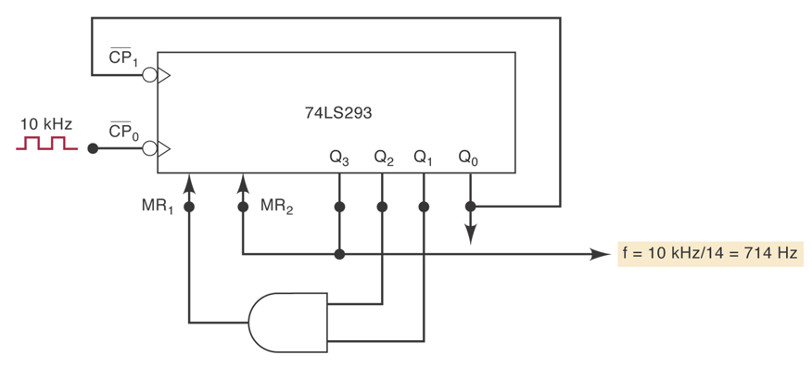
Example 5
Show how to wire the 74LS293 as a MOD-14 counter.
When the counter reaches (14) 1110 it should reset. That is when Q₁=Q₂=Q₃=1. But the built-in NAND gate has only 2 inputs. Therefore, an extra AND gate must be added to have all the three inputs fed together.

Slide 23
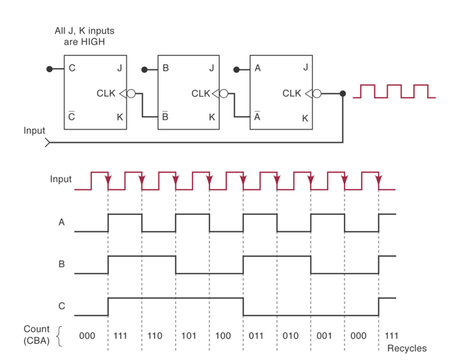
7-4 Asynchronous (Ripple) down counter
2³=8 ---> MOD-8 Down Counter

Slide 24
7-5 Propagation Delay in Ripple Counters
Ripple counters are the simplest type of counters.
Although they are simple, they have a major drawback which is the propagation delay caused by their operation principle.

Slide 25
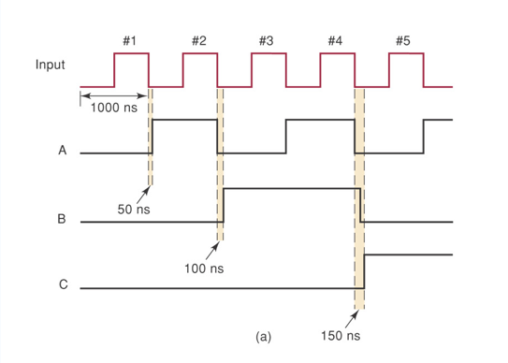
7-5 Propagation Delay in Ripple Counters

Slide 26
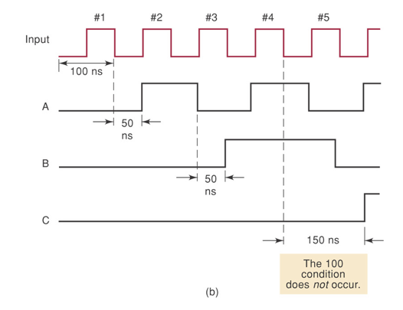
7-5 Propagation Delay in Ripple Counters

Slide 27
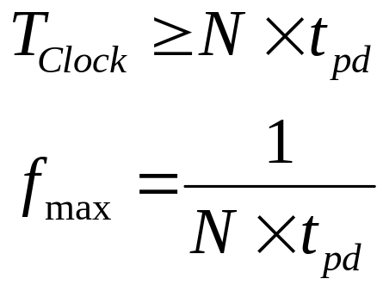
7-5 Propagation Delay in Ripple Counters
To avoid this problem, we should make sure of the following:
N = number of FFs
T_{pd} = propagation delay time

Slide 28
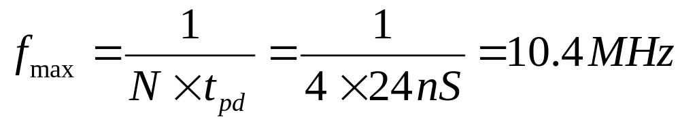
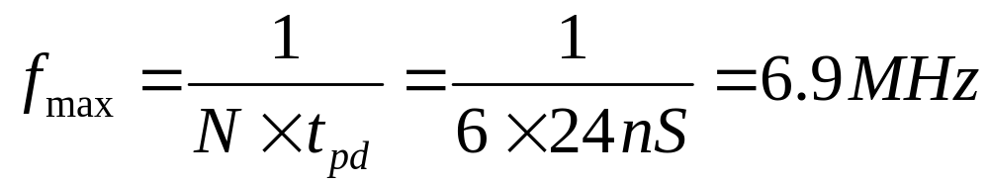
Example
A 4-bit Ripple counter with t_{pHL}= 16 nS and t_{pLH}= 24 nS, using 74LS112 J-K FF. find the maximum frequency for a proper operation of the counter. Assume a worst case scenario
For 6-bit Ripple counter that has 6 FFs.

Slide 29
7-6 SYNCHRONOUS (PARALLEL) COUNTERS
The synchronous counters have all of the FF’s triggered simultaneously. That is, all the CLK inputs are connected together
Synchronous counters require more circuitry than the asynchronous counters.
Synchronous counters needs extra logic gates to be added.

Slide 30
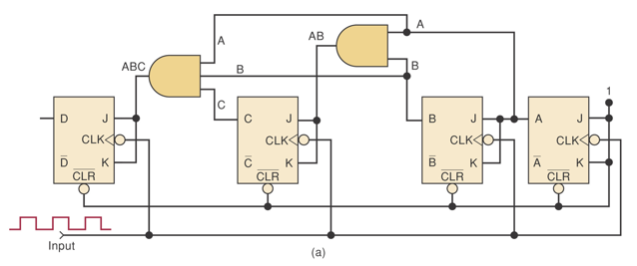
7-6 SYNCHRONOUS (PARALLEL) COUNTERS
Each FF should have its j and k inputs connected such that they are HIGH only when the outputs of ALL lower-order FFs are in the HIGH state

Slide 31
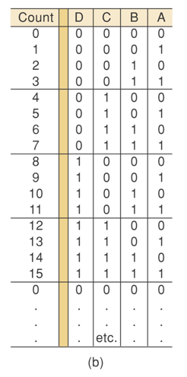
7-6 SYNCHRONOUS (PARALLEL) COUNTERS
Each FF is clocked by the NGT of the clock input signal so that all the FF transitions occur at the same time.
    Only A has its J-K inputs permanently at the HIGH level.
    A changes at each NGT clock (A FF toggles)
    B changes when A=1 and a NGT clock occurs
    C changes when A=B=1 and a NGT clock occurs
    D changes when A=B=C=1 and a NGT clock occurs

Slide 32
Advantage of synchronous Counters over Asynchronous
In a parallel counter, all FF will change simultaneously.
Propagation delay of FF do not add together to produce the overall delay.
Total delay = FF t_{pd} + AND t_{pd}
F_{max =} FF F_{max}+AND F_{max}
The total delay is the same no matter how many FF are used.
A synchronous counter can operate at much higher frequency, but the circuitry is more complex than that of the asynchronous counter.

Slide 33
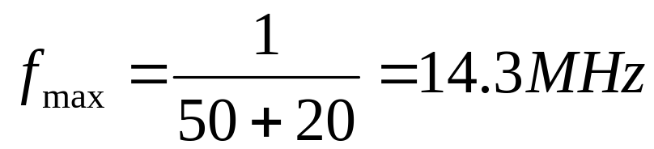
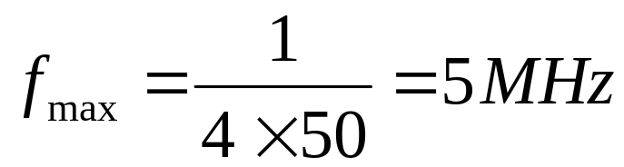
Example
Determine f_{max} for the synchronous MOD-16 counter if t_{pd}=50ns for each FF and t_{pd}=20ns for each AND gate.
Determine the equivalent f_{max} for asynchronous MOD-16 counter

Slide 34
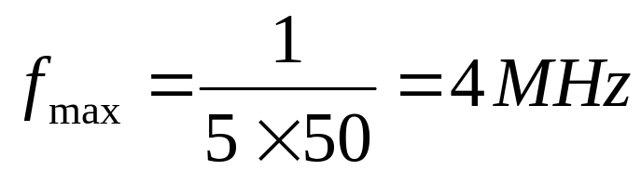
Example
What must be done to convert this counter to MOD-32 parallel counter?
A Fifth Flip-Flop must be added “2⁵=32”
Determine f_{max} for the MOD-32 parallel (synchronous) counter
For a MOD-32 ripple counter
Unchanged

Slide 35
7-7 Synchronous Down and Up/Down Counters
In the previous lecture, we’ve learned how synchronous counters work and how they differ from the asychronous counters in the specficiations and the propagation time delay.
Synchronous counters can be converted to down and up/down counters
The following circuit works as a synchronous Down counter by using the inverted FF outputs to drive the J-K inputs

Slide 36
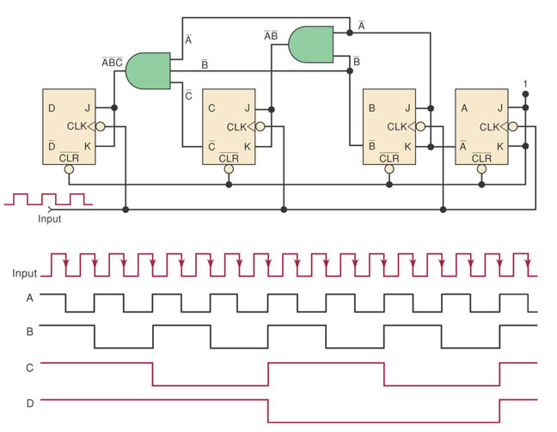
Synchronous Down Counter

Slide 37
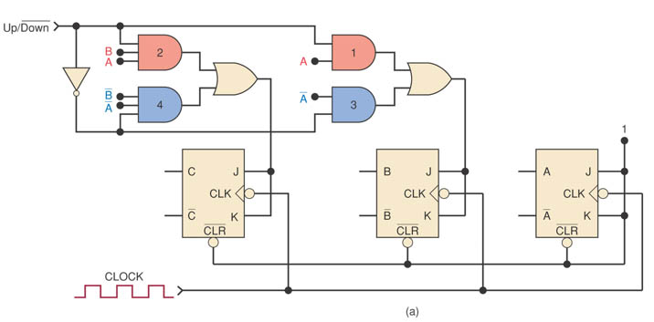
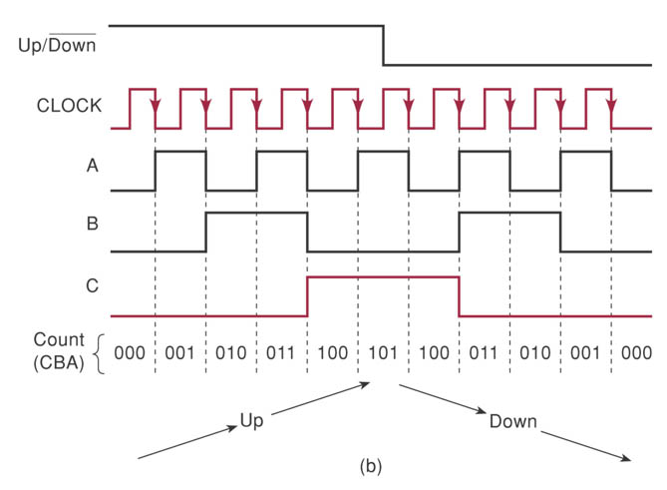

Slide 38
7-8 Presettable Counters
Many synchronous counters that are available as ICs are designed to be presettable.
Presettable means that the counters can be preset to any desired starting count.
The presetting operation is also referred to as parallel loading the counter.

Slide 39
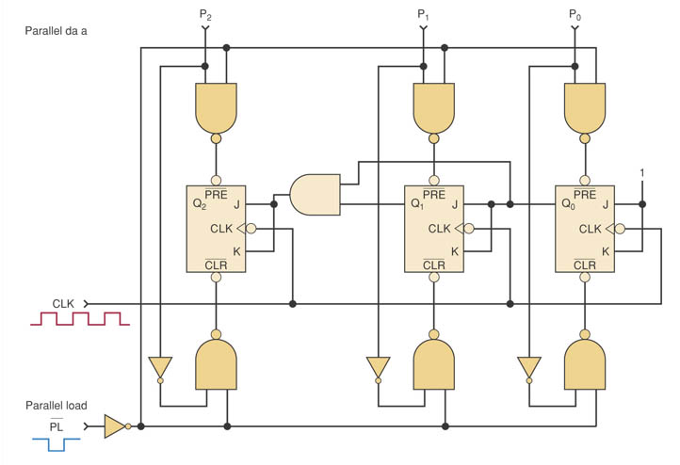
7-8 Presettable Counters

Slide 40
7-8 Presettable Counters
to perform asynchronous presetting. The counter is loaded with any desired count at any time by doing the following:
    1.Apply the desired count to the parallel data inputs, P₂, P₁, and P₀.
    2.Apply a LOW pulse to the PARALLEL LOAD input, PL.

Slide 41
7-13 Cascading BCD Counters
BCD counters are often used whenever pulses are to be counted and the results displayed in decimal.
A single BCD counter counts from 0 to 9 and then recycles to 0.
To count to a larger number than 9, we should cascade a multiple of BCD counters

Slide 42
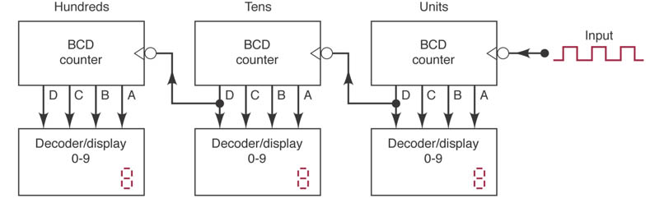
7-13 Cascading BCD Counters
For example, to construct a BCD counter operation that counts from 000 to 999 we should proceed with the following design:

Slide 43
7-13 Cascading BCD Counters
    1.Initially all counters are reset to 0.
    2.Each input pulse advances the first counter once.
    3.The 10th input pulse causes the counter to recycle, which advances the second counter 1.
    4.This continues until the second counter (10’s digit) recycles, which advances the third counter 1.
    5.The cycle repeat until 999 is reached and all three counters start again at zero.

Slide 44
7-14 Synchronous Counter Design
    Determine desired number of bits and desired counting sequence
    Draw the state transition diagram showing all possible states
    Use the diagram to create a table listing all PRESENT states and their NEXT states
    Add a column for each JK input. Indicate the level required at each J and K in order to produce transition to the NEXT state.
    Design the logic circuits to generate levels required at each JK input.
    Implement the final expressions.

Slide 45
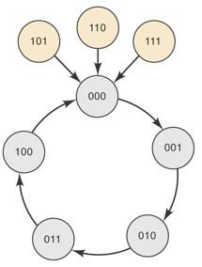
Example
STEP 1: determine the desired number of bits (flip-flops) and the desired counting sequence.
  We will use 3 JK Flip-flops to count from 000 to 100 “I.e from 0 - 4”
STEP 2: Draw the state transition diagram showing all possible states, including the undesired states.
  The undesired states should go back to 000

Slide 46
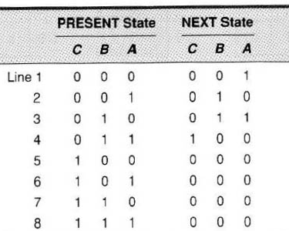
Example
STEP 3: Use the state transition diagram to set up a table that lists all PRESENT states and their NEXT state.

Slide 47
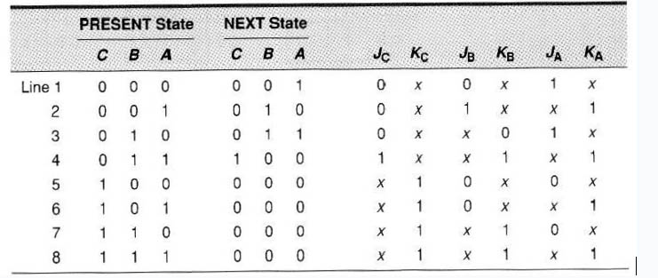
Example
STEP 4: Add a column to the previous table for each j and k input (Excitation table)

Slide 48
Example
Remember for a JK flip-flop the truth table Is :
Output Transitions |  | Flip-Flop Inputs
Q_{N} | Q_{N+1} | J | K
0 | 0 | 0 | x
0 | 1 | 1 | x
1 | 0 | _{X} | 1
1 | 1 | _{X} | 0

Slide 49
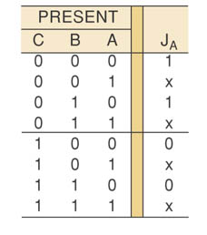
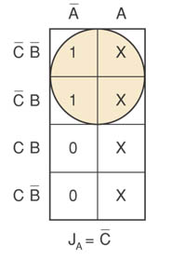
Example
STEP 5: Design the logic circuits to generate the levels required at each j and k input.
  Using Karnaugh Map “K-Map”

Slide 50
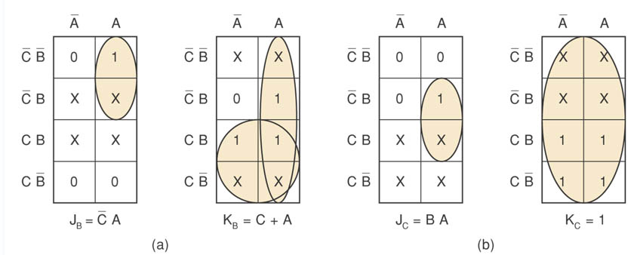
Example

Slide 51
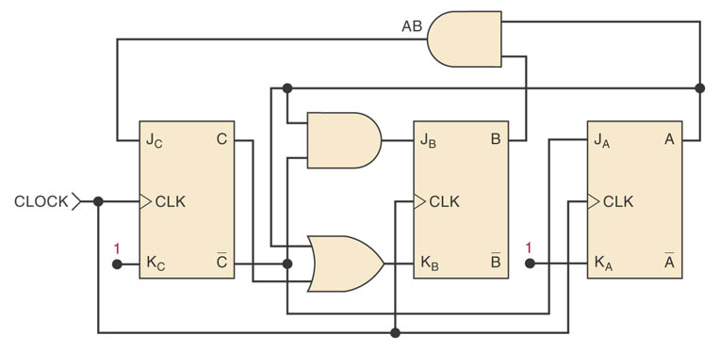
Example
STEP 6: Implement the final expressions
J_{A}= C’ K_{A}= 1
J_{B}= C’ A K_{B}= C+A
J_{C}= B A K_{C}= 1

Slide 52
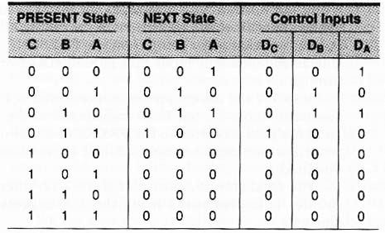
Example 2
Implement The Same Counter using D Flip-flops.

Slide 53
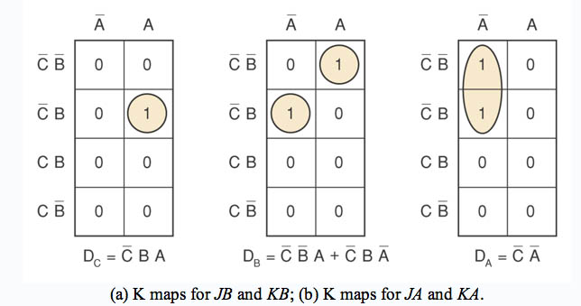
Example 2

Slide 54
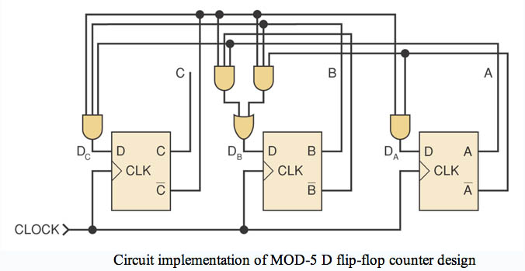
Example 3

Slide 55
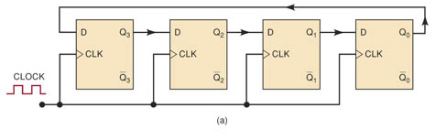
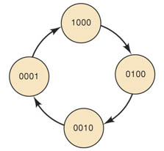
7-15 Shift Register Counters
Ring Counter (circulating shift register)
    Last FF shifts its value to first FF
    Uses D-type FFs (JK FFs can also be used)
    Must start with only one FF in the 1 state and all others in the 0 state.
Ring Counter: MOD-4, 4 distinct states
Does not count in normally binary sequence, but it is still a counter
Each FF output waveform frequency equals one- fourth of the clock frequency

Slide 56
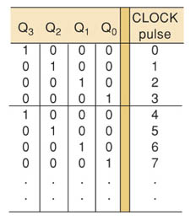
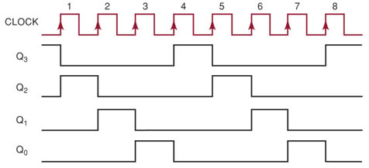

Slide 57
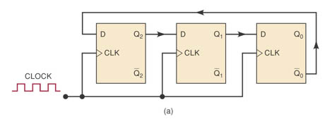
Johnson’s Counter
Johnson counter (Twisted ring counter)
    Same as ring counter but the inverted output of the last FF is connected to input of the first FF
    MOD is twice the number of FF
    (Example is MOD 6)
    Does not count normal binary sequence
    Six distinct states: 000, 100, 110, 111, 011, 001
    before it repeats the sequence
    Waveform of each FF is a square wave (50% duty cycle) at 1/6 the frequency of the clock

